Slide 1


Slide 2
Markup - Intro to CSS

Slide 3
Overview
By the end of this module you should have developed an understanding of:
Basic CSS style tags
Linking an external CSS to HTML
CSS3
HTML5 Elements

Slide 4
CSS
Cascading Style Sheets
CSS is a language that describes the style of HTML documents

Slide 5
CSS Syntax
A CSS rule-set consists of a selector and a declaration block.
Here’s the syntax for CSS:
selector {property: value;}

Slide 6
CSS Syntax
For Example:
h1 {color:blue,font-size:12px;}
h1 is the selector you wish to style
The declaration block contains one or more styles you wish to apply separated by semi-colons
The declaration block ends with a semi-colon and is enclosed in curly braces
Each declaration includes a property and a value

Slide 7
Types of CSS
Inline
Coded within the document for a single element
Internal
Coded within the document as a style tag. Used for a single document
External
A reference to an external CSS file is placed within the document. The file can be applied to many documents. This is the most common method

Slide 8
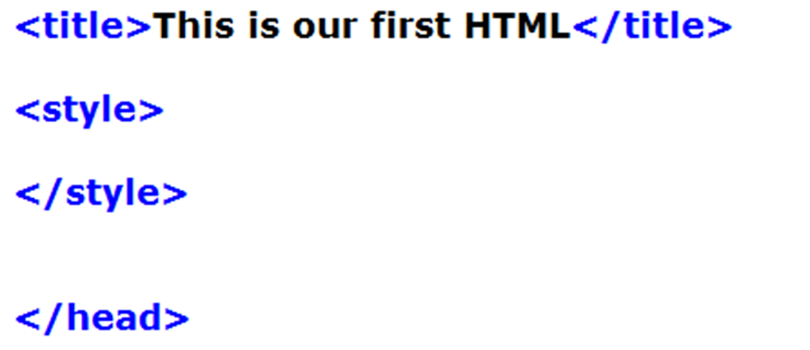
Internal CSS
To Style our HTML pages using internal CSS, the first thing we need to do is add a <style> tag within our <head> tag.

Slide 9
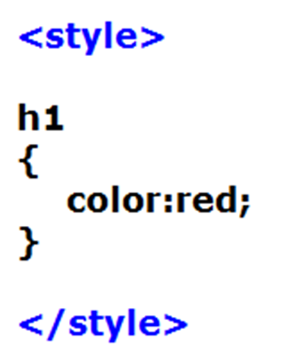
Internal CSS
Within our style tag we can insert our CSS. Let’s add our <h1> tag.
In CSS, selectors are patterns used to select the element(s) you want to style
For each selector there are “properties” inside curly brackets, which simply take the form of words such as color

Slide 10
Inline CSS
To use inline CSS, add the style attribute to the relevant element.
Example:

Slide 11
Our First CSS File
Since the most common method is an external CSS, we will create our CSS in this manner
Open firstname.html
We may wish to apply styles to any of the tags in this file
Save a new file named firstname.css which will contain our CSS styles

Slide 12
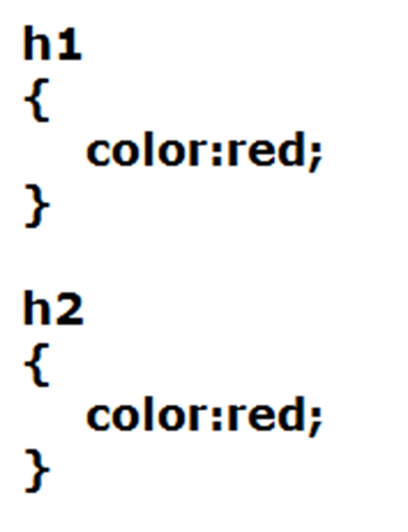
CSS
Let’s start with our <h1> and <h2> tags.
We will select the two tags we wish to style
To change the color of these two tags, we will declare the property and set the property value

Slide 13
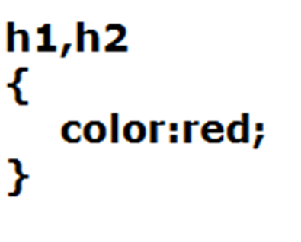
CSS
But what’s the problem with this, as programmers? We have some duplication. CSS allows us to group our selectors that may have similar styles.
Keep in mind that h1 and h2 still have their own distinct properties, like size. We’re only changing one property

Slide 14
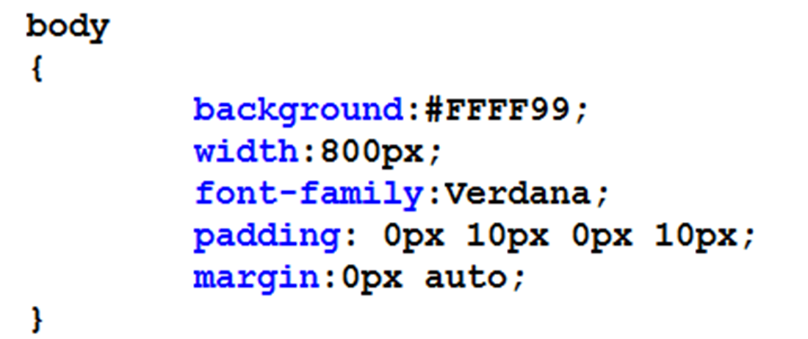
CSS
Let’s touch up our body a little. What’s going to be our CSS selector for the <body> tag?

Slide 15
CSS
Background is the background colour
Width is the content width of the document,
Font-family is a list of fonts that it tries to load. If it can’t find the first, it will move on to a second, third as available. If none are available, the browser will load a default font
Padding and margin are used to define margins and spacing for elements, in this case, the page. It uses a clock system, starting at the top, then right, bottom, then left. (12, 3, 6, 9 on the face of the clock).
If there is only 1 value, it applies to all sides.
If two elements, first is top/bottom, second is left/right

Slide 16
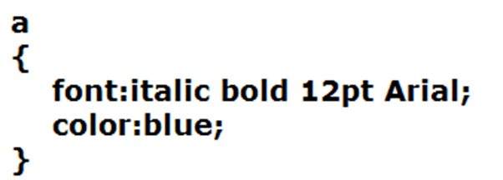
CSS
There’s one last part that we should cover; styling our links.
One thing that is nice with links, is that when we hover over them some kind of effect could be shown that helps the user know their mouse is on a link. To do this we can use CSS pseudo-classes.

Slide 17
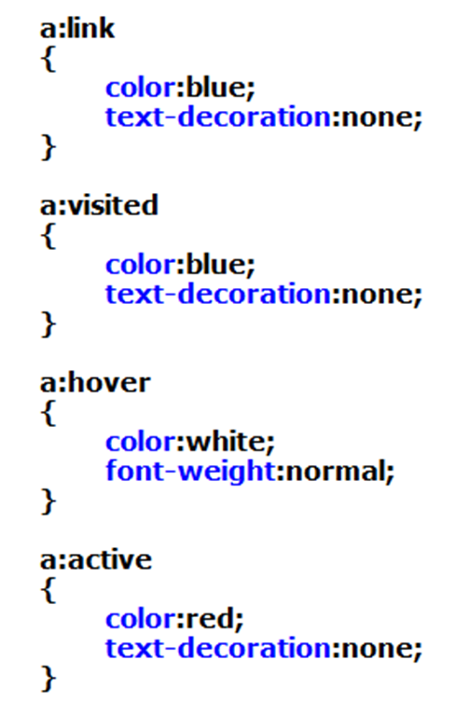
CSS
Universal Link
A visited link. Sometimes a browser will change the color of the link
When a user hovers over the link, we can set the colour
When the link is being clicked on

Slide 18
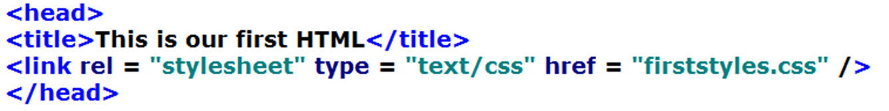
External CSS
Now all we need to do is create a link from our markup to our style sheet.
Now preview your HTML file in the browser and you should see the styles you applied.

Slide 19
Block and Inline Elements
Block elements apply to blocks of content, such as paragraphs, h1, h2, h3… type items, tables, forms
Inline elements apply to content within blocks, such as <a … /> tags, text decoration (strong, underline, etc) line breaks, etc.
Block elements have line breaks before and after, while inline elements do not.

Slide 20
Block Element Styles
There are 3 <p> tags in our HTML file. What if we want a style to only apply to one of these paragraphs? Well we can create a CSS class that we can attach to the tag we want to apply the class to.
This style will be created in our external CSS file and applied as a style to a block element

Slide 21
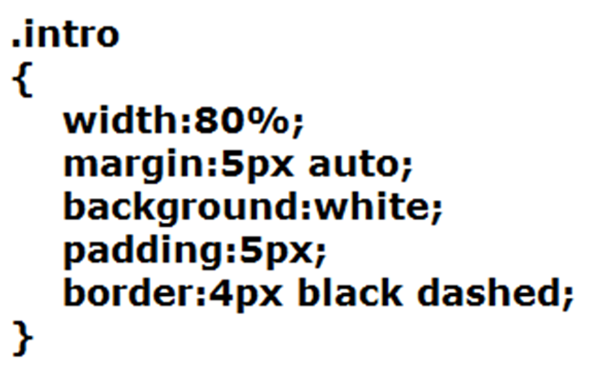
CSS
Add the following to the firstname.css file

Slide 22
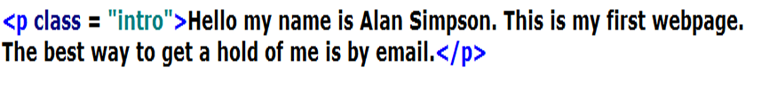
CSS
In firstdemo.html we will apply the style just to this one <p> tag
This is accomplished with the class attribute on the <p> tag
Preview your html file in your browser

Slide 23
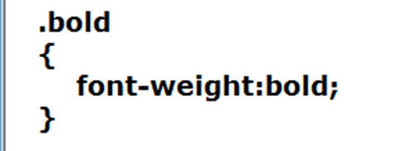
CSS
Let’s now look at making a certain amount of text bold
Add the following to your CSS file

Slide 24
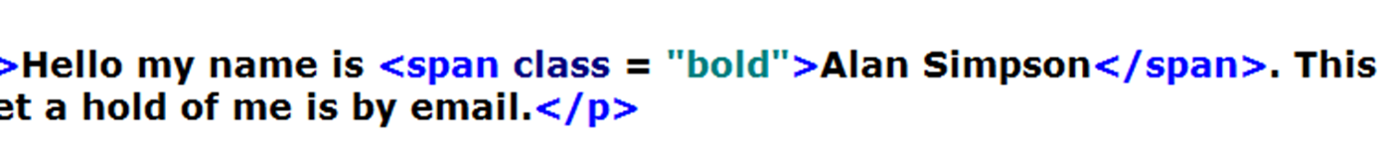
Inline Element Styles
Most elements in HTML are block elements, that is, they add a line break before and after their content. So what we want to do is just add an inline element, so we don’t break the flow.
For this we use the <span> tag and the class attribute

Slide 25
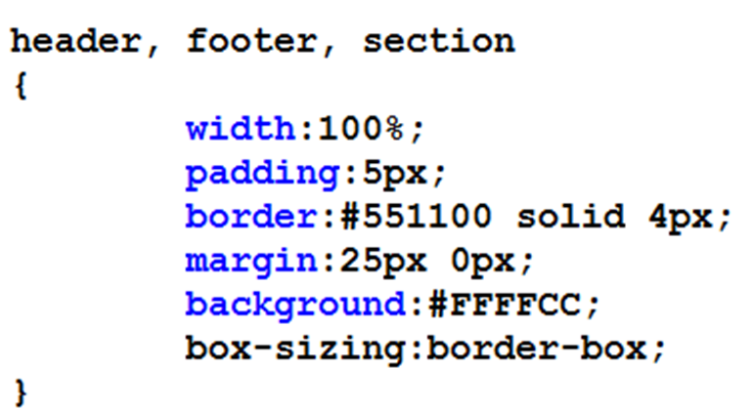
HTML5 Elements
Earlier on, we added header, footer, and section elements to our document. Now let’s take care of those HTML5 elements. We’ll add a border around our elements, add some padding and margins.

Slide 26
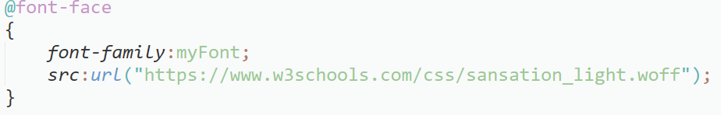
CSS3
Let’s add a couple more things that are newer to CSS. We’re going to change the font of the page to a web-font, using @font-face.
First, we declare a font that we’re going to use; providing a web address where the font can be found.

Slide 27
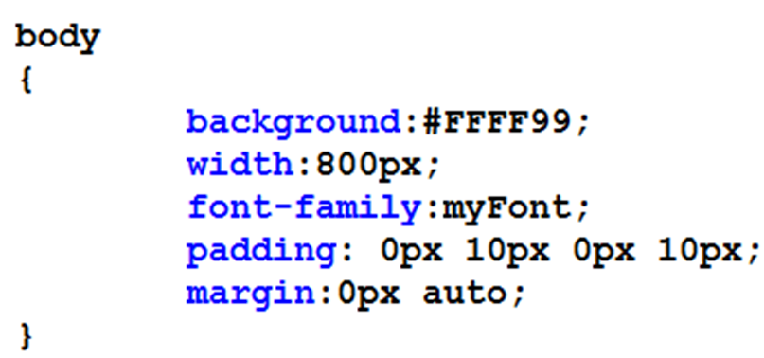
CSS3
Then we apply the name of our font to the body element selector
Preview in your browser

Slide 28
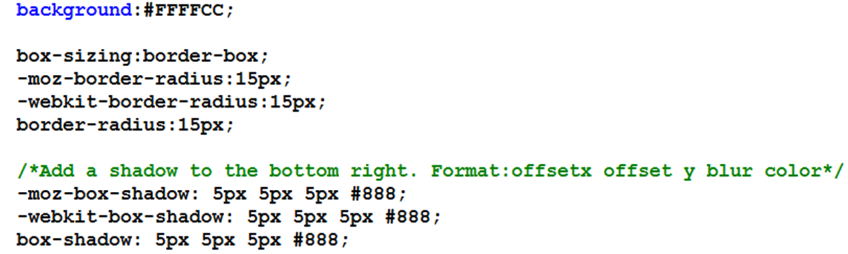
CSS3
CSS3 has some advanced styling features which can be vendor specific
Add the following to your CSS file

Slide 29
CSS3
The style will add a box and apply a shadow to the box. The edges will be rounded
Because browsers may display differently, we specify vendor prefixes
Some vendor prefixes: -moz for Mozilla (Firefox) -webkit for Safari and Chrome

Slide 30
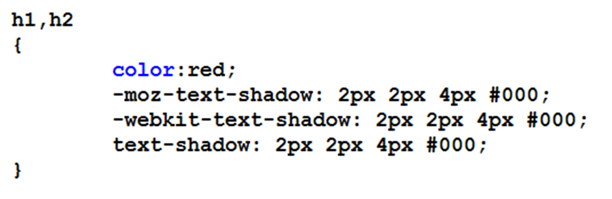
CSS3
We can also add a text-shadow that’s very similar to box-shadow. Let’s modify our headings. Preview in the browser.

